Slide 1
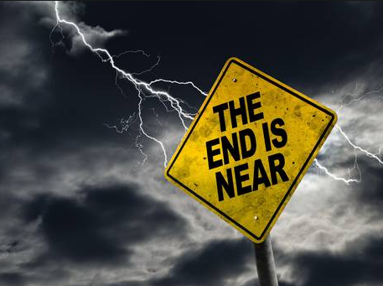

Slide 3
1 Peter 4:7
“The end of the world is coming soon.” [TLB]

Slide 4
1 Peter 4:7-11

Slide 5
The Salvation of the Soul

Slide 6
Salvation of the Soul
1 PETER
What is the Salvation of the Soul?
The Salvation of the soul is the total transforming work of God upon our lives, which is presently being realized in the midst of Christ like suffering, and which in the future will be unveiled in Christ like glory.

Slide 7
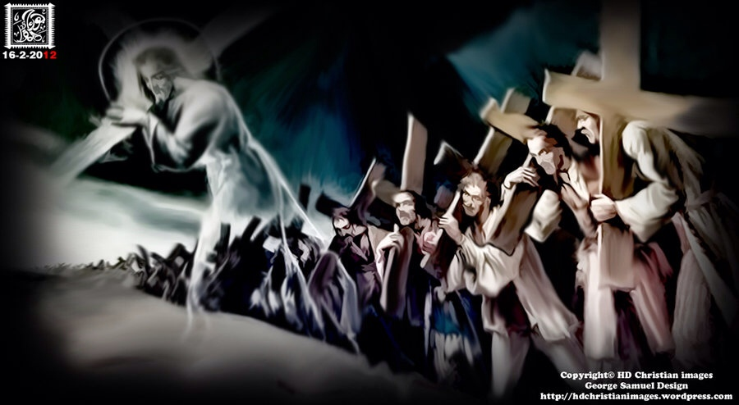
Salvation of the Soul
1 PETER
We are called to patiently endure unjust suffering just as Christ showed us the way to suffer.
Notes:
The example set before us is set in the past. Jesus shows us the way to suffer, to die, to live. We follow Him in the way to suffer and in the way of submission. Christ’s sufferings are the model on how to respond to injustice, for He experienced the greatest injustice of all. So we too are told to take up your suffering and follow Him in His footsteps. There are many others in the past who have taken up their crosses and suffered for Him patiently, will you do the same?

Slide 8
Salvation of the Soul
1 PETER
Outline

Slide 9
Salvation of the Soul
1 PETER
Body: Salvation of the Soul, Worked out in Experience – 1:13 – 4:19
In Relation:
to God – 1:13-21
to Brethren – 1:22 – 2:10
to the World – 2:11 – 3:7
to Life Itself – 3:8 – 4:6
to the Consummation of History – 4:7-19

Slide 10
Salvation of the Soul
1 PETER
In Relation to the End through Service to God
“But the end of all things is at hand; (4:7a)
“the end” – “telos” - the conclusion of an act or state; (termination) the result.
The Question is, what is the end of all things, and is it the same as the end of the age?
Notes:
Question? What is the end of all things and its it the same as the end of the age? Answer is to the second part is, No!

Slide 11
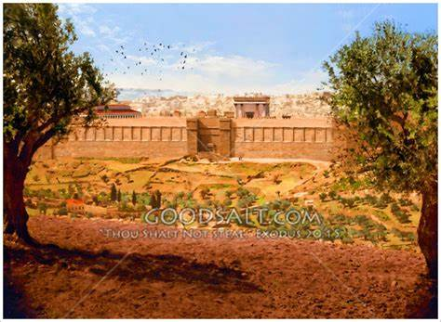
Salvation of the Soul
1 PETER
The End of the Age?
"Tell us, when will these things be? And what will be the sign of Your coming, and of the end of the age?” (Matt. 24:3)
Notes:
After Jesus tell His disciples the temple was going to be destroyed they then ask…

Slide 12
Salvation of the Soul
1 PETER
The End of the Age?
“you will hear of wars and rumors of wars. See that you are not troubled; for all these things must come to pass, but the end is not yet.” (24:6)
“And this gospel of the kingdom will be preached in all the world as a witness to all the nations, and then the end will come.” (24:14)

Slide 13
Salvation of the Soul
1 PETER
The End of the Age?
“For as the lightning comes from the east and flashes to the west, so also will the coming of the Son of Man be.” (24:27)
Notes:
This is then the end of the age.

Slide 14
Salvation of the Soul
1 PETER
The End of the Age?
“Immediately after the tribulation of those days… Then the sign of the Son of Man will appear in heaven, and then all the tribes of the earth will mourn, and they will see the Son of Man coming on the clouds of heaven with power and great glory.” (24:29-30)

Slide 15
Salvation of the Soul
1 PETER
The End of the Age?
“But each one in his own order: Christ the firstfruits, afterward those who are Christ's at His coming. Then comes the end, when He delivers the kingdom to God the Father, when He puts an end to all rule and all authority and power.” (1 Corinthians 15:23-24)
Notes:
The end of the age then is at the coming of Jesus Christ, the Son of Man, when he establishes His Kingdom on earth.
Strictly speaking we are not living in the end times. We are presently living in the last days when God’s Son has spoken (Hebrews 1:2), and will extend until the fullness of the Gentiles has come in (Romans 11:25). These last days will end with the coming of the Lord, after the tribulation, after the day of the Lord has come. Now, not everything that will happen in the last days has happen yet. “For the day of the Lord will come… (future tense) as a thief in the night. (2 Peter 3:10)
But the end of the age is not the end of all things, or everything. For Christ then establishes His 1000 year reign on earth.

Slide 16
Salvation of the Soul
1 PETER
The End of the Age?
“But he who endures to the end shall be saved.” (Matt 24:13)
“he” refers to those who are living during the tribulation and if they physical live to the end of the tribulation and the end of the age and see the coming of the Lord, they will be physically saved.

Slide 17
Salvation of the Soul
1 PETER
In Relation to the End through Service to God
“But the end of all things is at hand; (4:7a)
“Though now you do not see Him, yet believing, you rejoice with joy inexpressible and full of glory, receiving the end result of your faith — the salvation of your souls.” (1:8b-9)
Notes:
In order for us to understand what Peter is saying we have to look at it in context. How does Peter uses it elsewhere in topic.
(1:8b-9) Meaning, He who endures/remains faithful to the end will save his soul, receiving at the end of one’s faith — the salvation of your souls.” (1 Peter 1:9)

Slide 18
Salvation of the Soul
1 PETER
In Relation to the End through Service to God
“But the end of all things is at hand; (4:7a)
“For the time has come for judgment to begin at the house of God; and if it begins with us first, what will be the end result of those who do not obey the gospel of God? “ (4:17)
Notes:
What will be the end result of those who have not obeyed the command to believe and be eternally saved? It will neither be the salvation of their life, nor their soul.

Slide 19
Salvation of the Soul
1 PETER
In Relation to the End through Service to God
“But the end of all things is at hand; (4:7a)
The end of all things is the final result of our life.
At the conclusion of your faith/life there will be a final assessment or accounting of your service to God to determine the extent of your Soul Salvation.
Notes:
He who presently endures in faithful service, even in the midst of persecution, doing good to the end of their short time here will receive at the end the salvation of the soul, consisting in confession, praise and honor to rule with Him, and glory, and other precious rewards.
"Therefore whoever confesses Me before men, him I will also confess before My Father who is in heaven.” (Matt 10:32)
The lord said, ‘Well done, good and faithful servant; you were faithful over a few things, I will make you ruler over many things.” (Matt 25:21)

Slide 20
Salvation of the Soul
1 PETER
In Relation to the End through Service to God
“But the end of all things is at hand; (4:7a)
“at hand” – “eggizo” – to make near [NASB; NIV] approach; be at hand [KJV] “honde” [Tyndale Translation]
In no way does word “eggizo” mean here!
Notes:
In the past everyone knew what “at hand” meant. It means and only means that something was near. No one understood it to mean “hear”. Such as “the kingdom of God is hear”, or “in your midst”.
The NASB and the NIV translate it correctly as “the end of all things is near”

Slide 21
Salvation of the Soul
1 PETER
In Relation to the End through Service to God
“Now when they drew near Jerusalem, to Bethphage and Bethany, at the Mount of Olives, Jesus sent to of His disciples…” (Mark 11:1) [NKJV]; “nigh” [KJV]; “nye” [Tyndale]
In no way does word “eggizo” mean here!
Notes:
“Now when they drew near Jerusalem, to Bethphage and Bethany, at the Mount of Olives…” (Mark 11:1)
[NKJV]
Jesus and His disciples were not “here” in Jerusalem but were in Behtphage and Bethany… on the outskirts of Jerusalem.

Slide 22
Salvation of the Soul
1 PETER
In Relation to the End through Service to God
“Now after John was put in prison, Jesus came to Galilee, preaching the gospel of the kingdom of God, and saying, "The time is fulfilled, and the kingdom of God is at hand. Repent, and believe in the gospel.“ (Mark 1:14-15)
In no way does word “eggizo” mean here!
Notes:
“Now after John was put in prison, Jesus came to Galilee, preaching the gospel of the kingdom of God, and saying, "The time is fulfilled, and the kingdom of God is at hand. Repent, and believe in the gospel.“ (Mark 1:14-15)
Some say it means “here” because it fits their theology. Their theology is determining the meaning of “eggizo” to be “here”, instead of “near”. But clearly it does not mean “here”.

Slide 23
Salvation of the Soul
1 PETER
In Relation to the End through Service to God
The Kingdom is “here” – Reformed/Covenant.
The Kingdom is “here, but not yet” – Progressive Dispensational – Present and Future.
The Kingdom is “not yet” – Dispensational; Future.
Notes:
The Kingdom of God is “here” – Reform/Covenant- Presbyterian, Lutheran, Episcopalian, Anglican, Roman Catholic – the kingdom is here, now in a some subjective and intangible way, which they cannot fully explain, but is God is ruling the world, fulfilling the promises first given to Israel, now applied and carried out in and through the Church.
The Kingdom is “here, but not yet” is the Progressive Dispensational position. It’s the transitional position.
Have you heard of a “RINO” – “Republican In Name Only”, Progressive Dispensationalist is a DINO “Dispensational In Name Only” It is like “Progressive Creationism” which is nothing more than “Theistic Evolution” with a Christian or Biblical name. It’s really not Dispensational at all, but a departure from Dispensationalism. Now, I’ll explain what a “dispensation” and a “Dispensationalist“ is in a minute. Its not as hard as the big word sounds.
PD was developed in theological institutions, like Dallas Seminary, who’s doctrinal statements viewed the Kingdom of God on earth as a future reality, but who wanted to transition, so they said, to a kingdom “now” view. So they maintained the terminology, but departed from the theology, so they could remain in those institutions. Today almost all of theses theological institutions have departed, “transitioned” to the view of the Kingdom of God as being “here, but not yet fully here”.
The Kingdom is “not yet” is Dispensational - the kingdom is for a future age, the age to come.
A dispensation is a period of history (called an age, a connected idea) in which God’s is exercising His governing relationship. Not everyone agrees on how many dispensation there are, but God’s governing relationship is obviously different in each dispensation. God dispenses or distributes “oikonomos” his governing authority to different people at different times.
“oikonomos” sounds like “economy”. An “economy” is a dispensing or a distribution of wealth or capital, which is noting more than resource or tool, natural resources like trees, coal or oil, form wjich we get gasoline or even people is a resource. And there are different kinds of economies – free-market economies vs communist economies, which uses capital/resources in different ways. So it is with God’s “oikonomos”. God uses different governing relationships at different times.

Slide 24
Salvation of the Soul
1 PETER
In Relation to the End through Service to God
“the dispensation of the fullness of times”
(Ephesians 1:10)
The Dispensation of the Law
The Dispensations before the Law
“the dispensation of the grace of God”
(Ephesians 3:2)
Notes:
For example: God’s governing relationship in the future will be different than the present dispensation, in which He will be physically and personally ruling on the earth. [No longer in heaven, sitting on His throne at the right hand of the Father] He will at that time govern as the King of Kings and Lord of Lords. Ruling the nation of Israel and the nations through kings and lords, amongst others. Some kings may rule over entire nations, others, Lords, may rule over entire cities.
God’s governing relationship in the age previous was carried out through elders judges, priests, prophets and kings. The rule of Law was the Law of Moses.
And it is not to hard to see that there were different governing relationships of God with man in which he dealt with him in certain ways before the Law was given, before the time of Moses, with Abraham, Isaac and Jacob, before the time of Noah and with Adam.
His current governing relationship is through the Church by individuals called “steward” those who administer his ways through speaking and serving. The Greek word for “steward” is “oikonomos” a house-distributor (i.e. manager), or overseer. Stewards of God in the present management were apostles and prophets who laid the foundation, and pastor, teachers, evangelist, serving deacons and elders who continue the work of building Christ’s church.

Slide 25
Salvation of the Soul
1 PETER
In Relation to the End through Service to God
Every believer is a dispensationalist!
Every believer will have a final accounting!
Every believer from every age will have a final accounting!
Notes:
Therefore, if you are exercising your gift of speaking or serving, then you are a dispenser of the manifold grace of God” (4:10). You are whether you like it or not a dispensationalist. The only question remains is whether your are a good steward or not. There will be an accounting of our stewardship at the conclusion, “the end of all things.” Our stewardship will be judged according to the Law of Liberty “so speak and so do as those who will be judged by the law of liberty” (James 2:12)
“Let a man so consider us, as servants of Christ and stewards of the mysteries of God. Moreover it is required in stewards that one be found faithful.” (1 Cor. 4:1-2)
Stewards living during a different age will be judged by the responsibilities according to that age or dispensation. But all stewards will be judged!

Slide 26
Salvation of the Soul
1 PETER
In Relation to the End through Service to God
“But the end of all things is at hand; therefore…” –
Since the end is near you ought to behave accordingly…

Slide 27
Salvation of the Soul
1 PETER
“But the day of the Lord will come as a thief in the night, in which the heavens will pass away with a great noise, and the elements will melt with fervent heat; both the earth and the works that are in it will be burned up. Therefore, since all these things will be dissolved, what manner of persons ought you to be in holy conduct and godliness,” (2 Peter 3:10-12)

Slide 28
Salvation of the Soul
1 PETER
In Relation to the End through Service to God
With Prayer – 4:7b
With Love – 4:8
With Hospitality – 4:9
With His Gift – 4:10-11a
All for the Glory of God – 11:b
Notes:
Since the end of all things is near this leads us to soberness and prayer, (7b) love and hospitality, (8-9) and to God honoring service (10-11).
Peter describes how to live life with a end-time perspective.

Slide 29
Salvation of the Soul
1 PETER
In Relation to the End through Service to God
With Prayer – 4:7b
“be serious and watchful in your prayers.” (4:7b)
Notes:
Christians do not sell all their possessions and stand on a hilltop waiting for the end to come. Neither do they become “Doomsday Prepers”, stocking up on supplies hoping to survive the Day. Instead a end-time perspective drives us serious prayer and a watchful attitude.

Slide 30
Salvation of the Soul
1 PETER
In Relation to the End through Service to God
With love – 4:8
“And above all things have fervent love for one another, for "love will cover a multitude of sins.” (4:8)
Notes:
“above all things” shows the importance of this command, than even more important than prayer.
“fervent” means love is to be constant and intense, “agape” love sacrificial love expressed by the attitudes and actions found in 1 Corinthians 13:4-8a.

Slide 31
Salvation of the Soul
1 PETER
In Relation to the End through Service to God
With love – 4:8
“Since you have purified your souls in obeying the truth through the Spirit in sincere love of the brethren, love one another fervently with a pure heart.” (1:22)

Slide 32
Salvation of the Soul
1 PETER
In Relation to the End through Service to God
With love – 4:8
“And above all things have fervent love for one another, for "love will cover a multitude of sins.” (4:8)
Notes:
Peter is quoting Proverbs 10:12 that says, “Hatred stirs up strife, but love covers all sins”. He is explaining why (for) believers are to love each other fervently. By choosing to truly love the brotherhood one will not choose to pursue conflict when wronged by another brother or sister. Jesus taught His followers to forgive the offense and it resulted debt every time (Matt 6:12; 18:22-35)
“A commitment to loving others goes beyond simply tolerating them and looks for ways to serve others. Only love will enable believers to overlook offenses or offensiveness.” (Grace Commentary, page 1164)

Slide 33
Salvation of the Soul
1 PETER
In Relation to the End through Service to God
With Hospitality – 4:9
“Be hospitable to one another without grumbling.” (4:9)
Notes:
This command seems to build of the previous. Fervent love expresses itself with hospitality, done in a happy manner, without grumbling. Hospitality requires self-sacrifice that expects nothing in return. Christian love may be displayed by extending free food and lodging. “philoxenos” means being friendly to a stranger or foreigner. Remember we are all sojourners and pilgrims traveling on the earth (1:1)
During times of persecution, hospitality was especially welcome by Christians who were forced many times to flee for their lives and journey to new areas.

Slide 34
Salvation of the Soul
1 PETER
In Relation to the End through Service to God
With His Gift – 4:10
“As each one has received a gift, minister it to one another, as good stewards of the manifold grace of God.” (4:10)
Notes:
The primary stress of this subjection seems to be on the ministry of our gifts, which flows out of sober prayerfulness and love.
Not only do you receive the gift of eternal life when you believe, each of us, every believer also receives a gift from God for service. The gift is not for your own personal enjoyment, but is given so that you may “minister it to one another”. It is for the benefit of others.
We are all called, this is, your “call to the ministry”. Since all have a gift ‘charisma’ all believers are called to the ministry, “diakoneo” the same root word from which comes the word “deacon”.
We view our ministry of service to others as a steward “oikonomos” a dispenser/distributor—a dispensationalist of the various gracious acts of God. The gifts God gives expresses various aspects of His grace directed toward His children. As stewards of God’s grace we are made channels through which His grace flows into the lives of others.
There are basically two kinds of gifts: speaking gifts and serving gifts.

Slide 35
Salvation of the Soul
1 PETER
In Relation to the End through Service to God
With His Gift – 4:10
“If anyone speaks, let him speak as the oracles of God. If anyone ministers, let him do it as with the ability which God supplies,” (4:11a)
Notes:
There are basically two kinds of gifts: speaking gifts and serving gifts, though many times they overlap.
Those who speak, do so as if they are uttering the very words of God. We are to speak with divine authority as God’s mouthpiece. “anyone” includes everyone who has a specking role in the church, whether teaching, preaching, counseling, leading in prayer or in music, or in visiting.
If we serve or when you serve our strength comes from God. We all have the strengthener, the Holy Spirit to call upon to help us carry out the task. We can do all things through Him who provides the strength in abundance.
He does not say you are to serve when you have enough ability or when you become fully qualified, but we are to serve according to the ability God has given.

Slide 36
Salvation of the Soul
1 PETER
In Relation to the End through Service to God
All for the Glory of God – 11:b
“that in all things God may be glorified through Jesus Christ, to whom belong the glory and the dominion forever and ever. Amen.” (4:11b)
Notes:
The ultimate aim of all ministry is the divine glory for God. The glory will be His very ever. No one can ever take away God’s glory. We serve Him not for our personal glory but for His. But then he amazingly shares His glory with us.
The manifestation of God’s glory is the climatic conclusion of all things. The purpose of all things is doxological and theocentric -- to the praise of God.
The whole story of the Bible is to this end. As important as it is, the death and resurrection of Christ is not the climax to the story. The main theme of the Bible is not Salvistic or Christocentric. It certainly demonstrates His love for us and is a manifestation of His glory in the redemption of humanity. The death and resurrection is the bases upon which makes the climax possible, which is the glorious return of Christ to the earth, establishing His future kingdom with us and to bring all things in subject to Him.
“Amen” is the Hebrew original literally “so be it”, meaning “it is a truthful statement”.

Slide 37
Salvation of the Soul
1 PETER
Conclusion
Notes:
The final accounting of our stewardship could accord at any moment, we could physically die at any moment or the Lord could come at any moment, it is imminent. There are no signs of His coming. No one knows the day or the hour the coming of the Lord of us will occur. Are you ready for your final assessment?

